Slide 1


HS 2015
Current Trends in Distributed Systems
Apache Storm
Group:
Patrick Zumsteg
Simon Wallny
Philipp Oldenburg

Slide 2
Contents
What is Storm?
Functionality
  The Cluster
  Zookeeper
  Topologies
HS 2015
Current Trends in Distributed Systems – Project Idea

Slide 3
What is Storm?
Framework for distributed data stream processing
  Aims to optimally distribute tasks among nodes
Used for continuous in-/out-streams
Very resilient
  „dead“ nodes easily restarted, jobs reassigned
Still in beta phase
HS 2015
Current Trends in Distributed Systems – Project Idea

Slide 4
How does it work?
Cluster of nodes
  1 master node
  Multiple worker nodes
Each node runs a daemon
  Nimbus (master node)
  Supervisors (workers)
Node != physical device
  Multiple nodes per device
HS 2015
Current Trends in Distributed Systems – Project Idea

Slide 5
The Storm Cluster
Nimbus:
  Assigns tasks to supervisors
  Distributes code
  Reacts to dead workers
Supervisor:
  „mindless“ worker
  Runs worker process(es)
  Based on orders from Nimbus
Nimbus can't single-handedly control all workers
  Helpers: the ZooKeepers
HS 2015
Current Trends in Distributed Systems – Project Idea

Slide 6
Between master and slave: the ZooKeeper
Apache ZooKeeper
  Node in the cluster
Similarities to a file system
  Hierarchical data structure
  Every node contains data
  Data kept in memory → small files
  High throughput; optimized for large DS
Clients connect to ZooKeeper-server
  State information of Supervisors via heartbeat
  Nimbus makes decisions based on ZK information
Downside: bigger ZK-Cluster → slow write-requests
  Write-request passed to all ZK-nodes
HS 2015
Current Trends in Distributed Systems – Project Idea

Slide 7
Storm Topologies
The job which the cluster carries out
Primary building block: the Task
  Spout continuously outputs data
  Bolt processes (and outputs) data
HS 2015
Current Trends in Distributed Systems – Project Idea

Slide 8
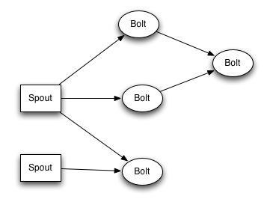
Spouts and Bolts
HS 2015
Current Trends in Distributed Systems – Project Idea

Slide 9
Storm Topology: Arranging Tasks
Tasks are grouped in Executor-threads
  Rule of thumb: one Task per Executor
Executors grouped into Working Processes
Nimbus assigns WP to Supervisor nodes
  Also evenly distributes Executors among WP
  Tries to optimize load balance
  If worker node dies: WP is now „free“, reassigned
No direct control over assignment to WP (and to physical devices)
HS 2015
Current Trends in Distributed Systems – Project Idea

Slide 10
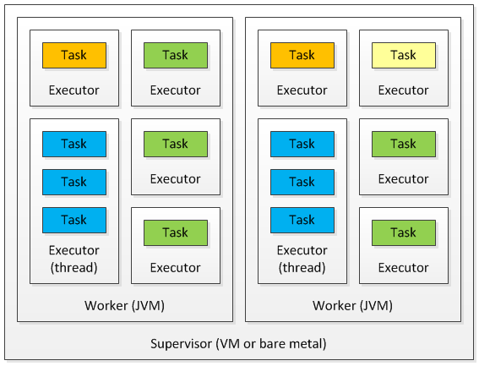
Storm Topology: Arranging Tasks
HS 2015
Current Trends in Distributed Systems – Project Idea

Slide 11
Storm vs. Competition
Hadoop: MapReduce job instead of topology
  MR processes batch of data, then terminates
  Topology processes data streams indefinitely
Spark: also tailored towards batch processing
  Like Hadoop, but much faster due to in-memory data storage
  Streaming: Spark chops stream up into batches
  Storm processes stream directly
HS 2015
Current Trends in Distributed Systems – Project Idea

Slide 12
HS 2015
Current Trends in Distributed Systems
Apache Storm
Group:
Patrick Zumsteg
Simon Wallny
Philipp Oldenburg

